Slide 1

STL
Programming Club - AKGEC

Slide 2
The Standard Template Library (STL) is a set of C++ template classes to provide common programming data structures and functions such as lists, stacks, arrays, etc. It is a library of container classes, algorithms, and iterators.

Slide 3
Vector
Programming Club - AKGEC

Slide 4
Vector
Vectors are same as dynamic arrays with the ability to resize itself automatically when an element is inserted or deleted, with their storage being handled automatically by the container.

Slide 5
int n;
cin>>n;
int a[n]; n=5
index
0
1
2
3
4
1 | 3 | 6 | 5 | 9
a[0]
a[1]

Slide 6
vector <int> v;
v.size()=4;
push_back( x )
pop_back()
size( )
emplace_back(x)
0 1 2 3 4
1 | 2 | 3 | 4

Slide 7
#include<bits/stdc++.h>
using namespace std;
int main()
{
vector<int> v;
int n;
cin >> n;
for(int i=0; i<n; i++)
{
v.push_back(i);
}
v.push_back(10);
for(int i=0; i<v.size(); i++)
{
cout<<v[i]<<" ";
}
cout<<endl;
v.pop_back( );
v.pop_back( );
int len=v.size( );
cout<<len<<endl;
for(int i=0; i<v.size(); i++)
{
cout<<v[i]<<" ";
}
return 0;
}
INPUT
5
Output
0 1 2 3 4 10
4
0 1 2 3

Slide 8
Pair
Programming Club - AKGEC

Slide 9
Pair
A pair is a container which stores two values mapped to each other. A vector containing many such pairs is called vector of pairs.
Syntax:
pair<datatype1, datatype2> pair_name;
Example:
pair<int, string> p;
p.first = 1; p.second = “one”;
OR
p = make_pair(1, “one”);

Slide 10
Iterators
Programming Club - AKGEC

Slide 11
An iterator is any object that, pointing to some element in a range of elements (such as an array or a container), has the ability to iterate through the elements of that range using a set of operators (with at least the increment (++) and dereference (*) operators).

Slide 12
begin( )
end( )
rbegin()
rend()
int v[4] = {2, 15, 10, 7}
0 1 2 3
2
15
10
7
v.rend( )
v.begin( )
v.rbegin( )
v.end( )

Slide 13
0 1 2 3
2
15
10
7
v.begin( )
v.begin( ) + 2

Slide 14
for(auto it = v.begin(); it != v.end(); it++)
0 1 2 3
2
15
10
7
it
it
it
it
v.end()

Slide 15
Sorting
Programming Club - AKGEC

Slide 16
Sort
We can sort vector or arrays using the built in sort() function
Time Complexity: O(N*Log(N))
Syntax:
sort(arr, arr + n) //n = size of the array
sort( vec.begin(), vec.end() ) //using iterators

Slide 17
Comparator
It is a very powerful tool of sorting used extensively in competitive programming and DSA.
Syntax:
sort( vec.begin(), vec.end(), compare);
Here, compare is the name of the function that you have to write. It should be a function that returns boolean.

Slide 18
Case 1:
To sort a vector in descending order
bool compare(int a, int b){
return a > b;
}
5 | 4 | 3 | 2 | 1
a
b
Case 2:
To sort a vector of pair according to the second element:
bool compare(pair<int, int> a, pair<int, int> b){
return a.second < b.second;
}

Slide 19
Map
Programming Club - AKGEC

Slide 20
MAP
Maps are part of the C++ STL (Standard Template Library). Maps are the associative containers that store sorted key-value pair, in which each key is unique and it can be inserted or deleted but cannot be altered. Values associated with keys can be changed.

Slide 21
Database --
Roll no -----> Student’s Name
sorted
MAP ----------> (Key-Value Pair)
(Index)
A
B
unique
Key
Value
0
24
45
46
47
54
Hema
Rekha
Jaya
Sushma
Nirma
24 | Hema
45 | Rekha
46 | Jaya
47 | Sushma
54 | Nirma
1
2
3
4

Slide 22
#include<bits/stdc++.h>
using namespace std;
int main()
{
map<int, int> mpp;
int n;
cin >> n;
for(int i=0; i<n; i++)
{
int x; cin>>x;
mpp[x]++;
}
cout<<”Frequency of 2”<<endl;
cout<<mpp[2]<<endl;
INPUT
5
2 2 2 10 11
Output
Frequency of 2
3

Slide 23
Map vs Unordered Map
 | Map | Unordered Map
Ordering | Ascending Order (sorted on the basis of keys) | No Order
Implementation | Red-Black Trees (A Self-Balancing Tree) | Hash Table
Search Trime | O(log(n)) | O(1) -> Average Case O(n) -> Worst Case
Insertion Time | O(log(n)) | O(1) -> Average Case O(n) -> Worst Case
Deletion Time | O(log(n)) | O(1) -> Average Case O(n) -> Worst Case

Slide 24
Set
Programming Club - AKGEC

Slide 25
Set
Sets are a type of containers in which each element has to be unique because the value of the element identifies it. The values are stored in a specific order.
Properties:
No duplicates
Sorted in ascending order.
Searches an element in O(log n) time.
Unindexed.
We can compromise with the sorted order for improving the search time, by using unordered set, which has search time of O(1).

Slide 26
Set
Insert 5
5
insert()
erase()
size()
find()
count()
Insert 2
2 | 5
Insert 4
2 | 4 | 5
Insert 3
2 | 3 | 4 | 5

Slide 27
#include<bits/stdc++.h>
using namespace std;
int main()
{
set<int> st;
int n;
cin >> n;
for(int i=0; i<n; i++)
{
int x; cin>>x;
st.insert(x);
}
for(auto it = st.begin();
it != st.end(); it++){
cout<<*it<<” “;
}
auto i = st.find(10);
st.erase(i);
for(auto it = st.begin();
it != st.end(); it++){
cout<<*it<<” “;
}
}
INPUT
5
10 2 2 2 11
Output
2 10 11
2 11

Slide 28
Set vs Unordered Set
 | Set | Unordered Set
Ordering | Ascending Order | No Order
Implementation | Red-Black Trees (A Self-Balancing Tree) | Hash Table
Search Time | O(log(n)) | O(1) -> Average Case
Insertion Time | O(log(n)) | O(1) -> Average Case O(n) -> Worst Case
Deletion Time | O(log(n)) | O(1) -> Average Case O(n) -> Worst Case

Slide 29
Stack
Programming Club - AKGEC

Slide 30
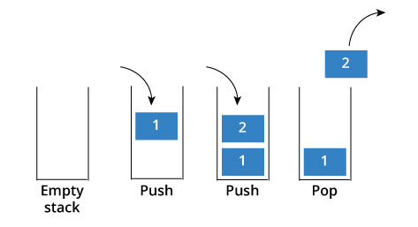
Stack
Stack is a linear data structure which follows a particular order in which the operations are performed. The order followed is LIFO(Last In First Out).
There are many real-life examples of a stack. Consider an example of plates stacked over one another in the canteen.

Slide 31
#include<bits/stdc++.h>
using namespace std;
int main()
{
stack<int> s;
s.push(10);
s.push(20);
s.push(30);
s.top();
s.pop();
return 0;
}
30
20
20
20
10
10
10
10

Slide 32
Queue
Programming Club - AKGEC

Slide 33
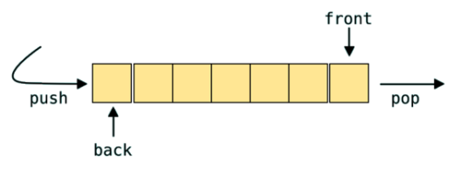
Queue
Queue is a data structure designed to operate in FIFO (First in First out) context. In queue elements are inserted from rear end and get removed from front end.

Slide 34
#include<bits/stdc++.h>
using namespace std;
int main()
{
queue<int> q;
q.push(10);
q.push(5);
q.pop();
return 0; }
10
5
10
5

Slide 35
Priority Queue
Programming Club - AKGEC

Slide 36
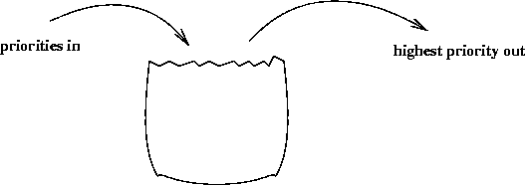
Priority Queue
Priority queue is a container which is designed such that the first element of the queue is greatest of all the elements and the elements are in descending order.
Time Complexity: O(Log(N)) //Insertion and Deletion
Syntax:
priority_queue<int> q;

Slide 37
#include<bits/stdc++.h>
using namespace std;
int main()
{
priority_queue <int> q;
int n;
cin >> n;
for(int i=0; i<n; i++)
{
int x; cin>>x;
q.push(x);
}
cout<<”Size of priority_queue ”;
cout<<q.size()<<endl;
//Printing the greatest element
cout<<q.top()<<endl;
q.pop();
cout<<q.top()<<endl;
}
INPUT
5
3 1 9 2 7
Output
Size of priority_queue: 5
9
7

